Slide 1
Analysis of Irregular Spatial Data with Machine Learning:
Classification of Building Patterns with a Graph Convolutional Neural Network
(2018)

Slide 2
Datasets:
Building Pattern Classification: regular or irregular

Slide 3
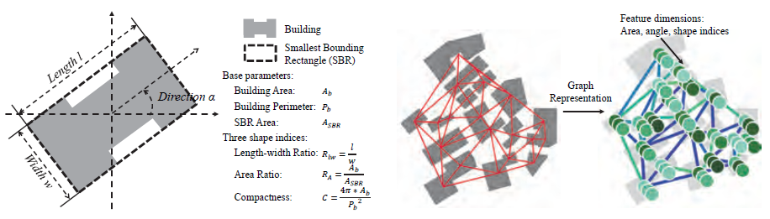
Motivation: irregularity

Slide 4



Graph Fourier transform
Convolution on graph

Slide 5
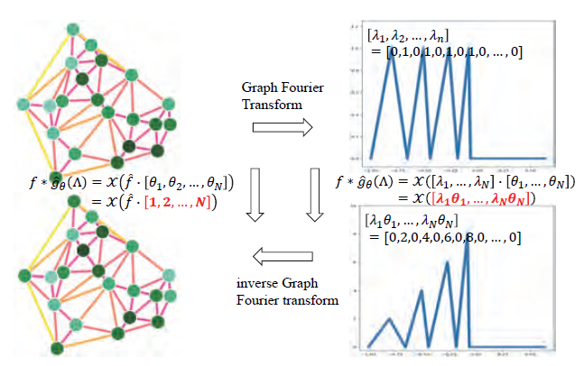

Slide 6

Polynomial approximation for fast localized convolution

Slide 7
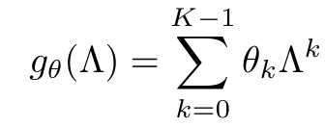
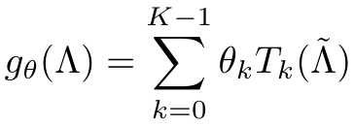

Chebyshev

Slide 8
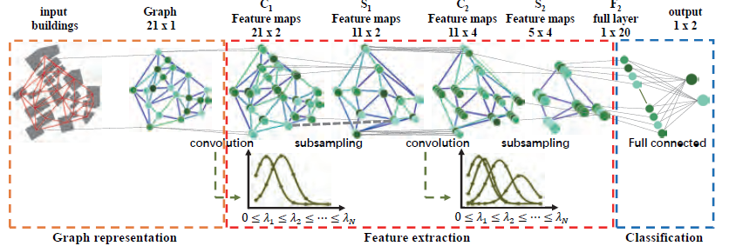
Graph is an ideal tool to describe the relationships between multiple objects:
Delaunay triangulation (DT) and Minimum Spanning Tree (MST)

Slide 9
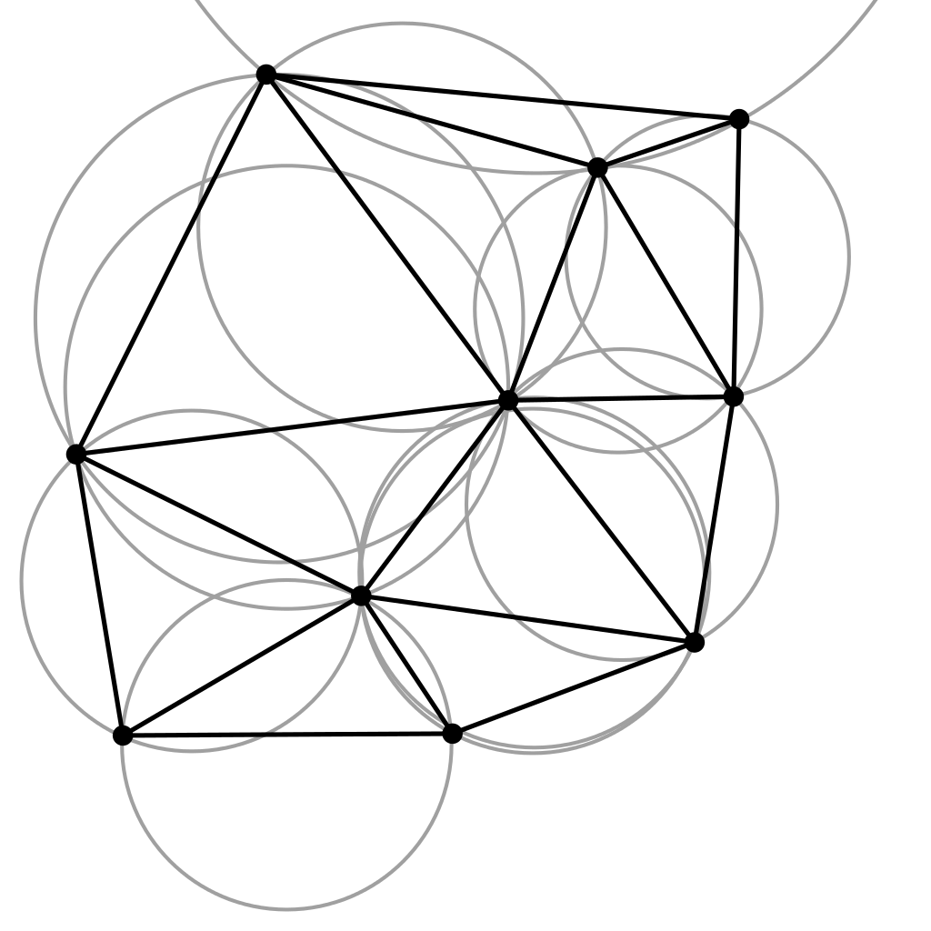
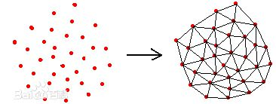
Delaunay triangulation (Delaunay三角剖分算法)
1、除了端点，平面图中的边不包含点集中的任何点
2、没有相交边
3、平面图中所有的面都是三角面，且所有三角面的合集是
所有点集合的凸包
4、任意四点不能共圆

Slide 10
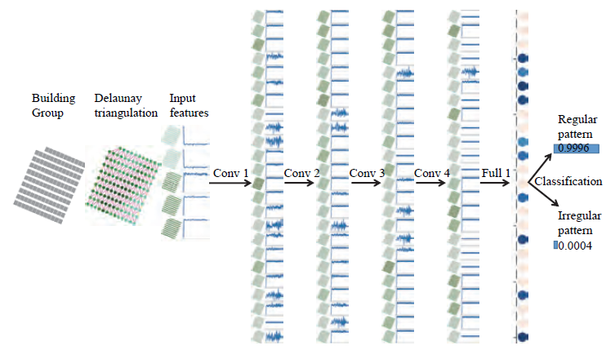
Model

Slide 11

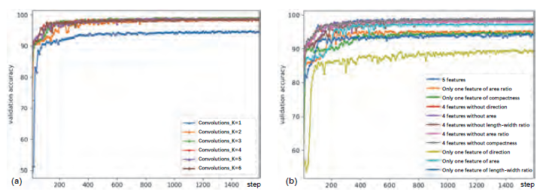
Experiment

